Slide 1
Title (Brand Vehicle model Product)
Segment: choose from list on next slide
Category: choose from list on next slide
Please provide your photo also separately in Full HD with the right source: Motherson photo or a photos from the customer’s website, best with the URL of the media library
Project Code
Full Service Supply project or Built to print
Development Location
Production Location
Volume p. year
Other topics
(SOP: )
1
Contact: name of contact person
Function: function of contact person
Division: Modules and Polymer Products
Company: SMP
Email: email of contact person
Last modified: for ex. 16-05-2023
1

Slide 2
Fact sheet_Categorisation
Segment
Choose 1 item
Category
Choose 1 items
Main advantages
Choose min.1 and max. 5 items
Examples
Cockpit modules
Instrument panels
Centre consoles
Door panels
Electric & electronic integration
Sustainable materials
Decoration technologies
Sustainable processes
Front-end
Rear-end
Body panels
Interior mirrors
Exterior mirrors
Digital vision systems
ADAS
Additive Manufacturing for small/midsize volume
Passenger air-bag scoring, Assembly
Armrest
Handle, Storage
HMI, Decoration lighting, Sound and music, Wireless, Heating, Sensors, Air intake
Greener carriers, Greener Skins & Foils, Greener foams
Painting, Silk printing, Digital printing, Films, foils & Fabric lamination, Real metal
Front end module, Front bumper module, Fascia, Grille, Centre cover
Rear bumper, Integrated tailgate
Rear Spoiler, Rocker panel, ID Buzz Front panel, Pillar covers
CMS
Product
Software
Technology
Material
Service
Demonstrator
Cost reduction
Enhanced experience
Enhanced performance
Legislation, compliancy
Manufacturing improvement
Methodology
Modularity
New feature
Safety
Size reduction
Sustainability
System integration
Weight reduction

Slide 3
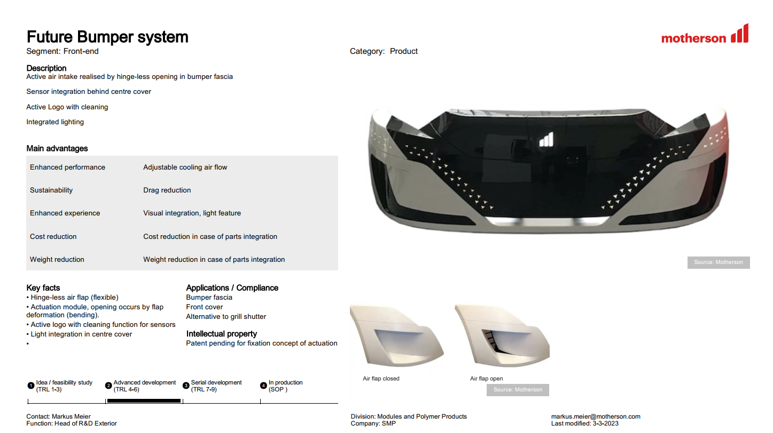

Slide 4
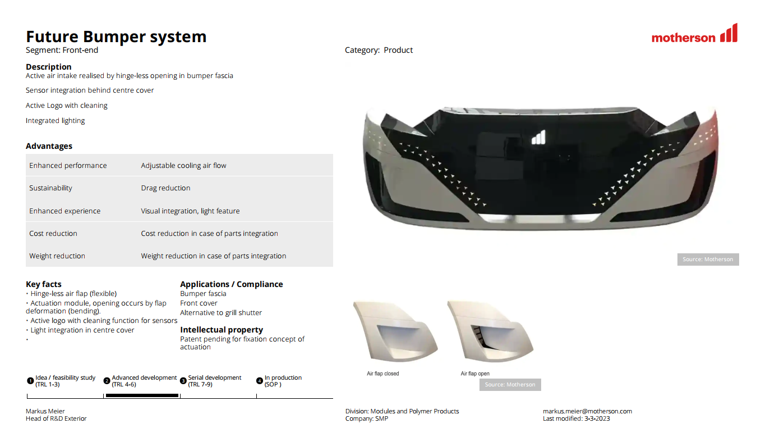

Slide 5
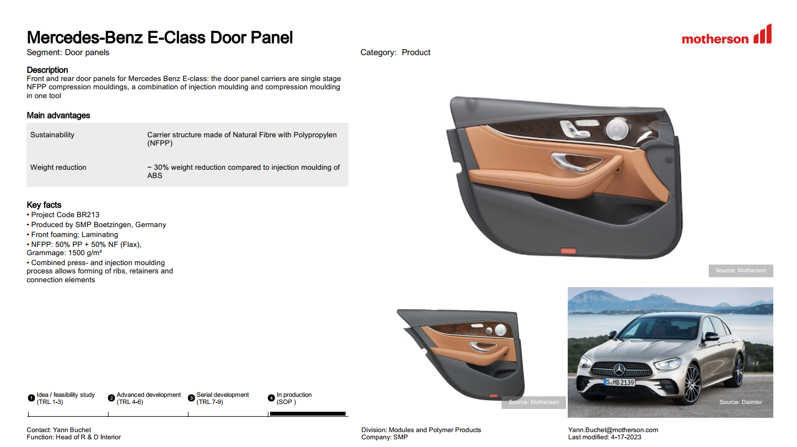

Slide 6


Slide 7
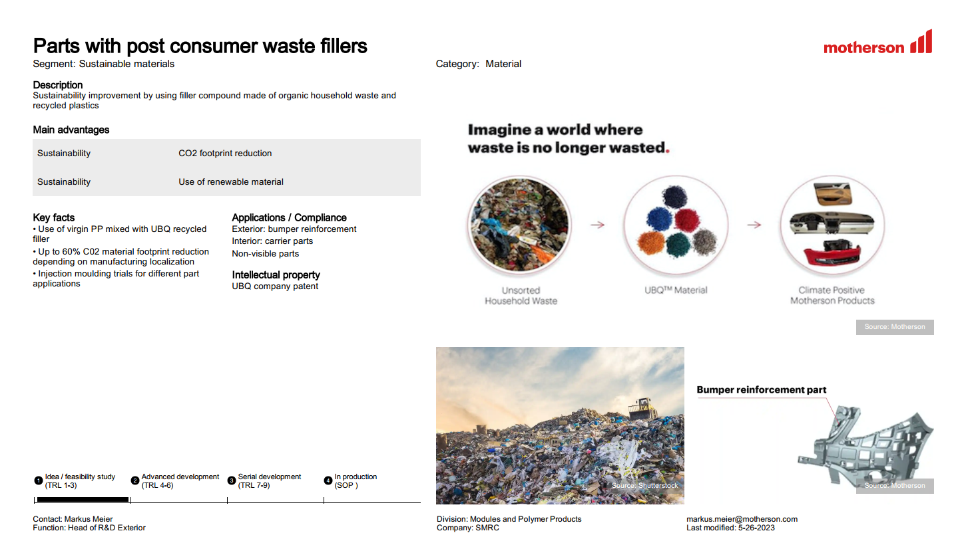

Slide 8
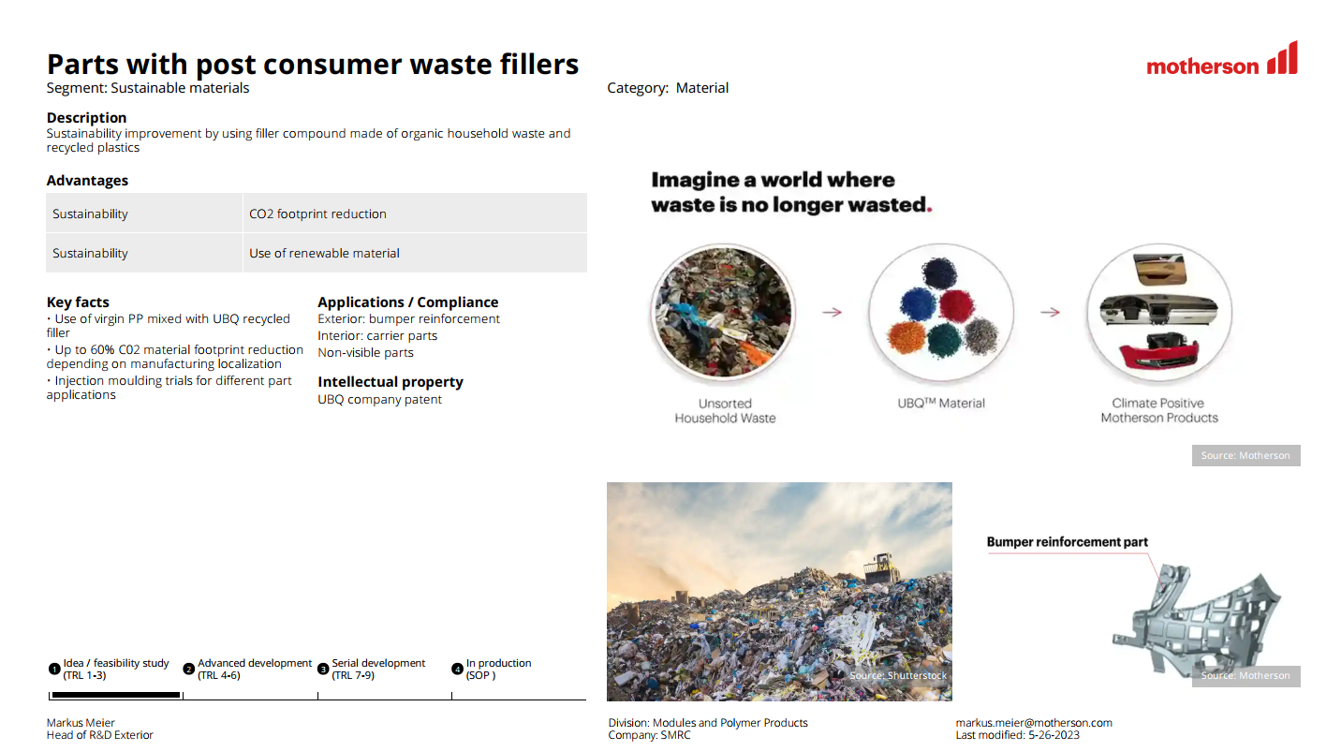

Slide 9
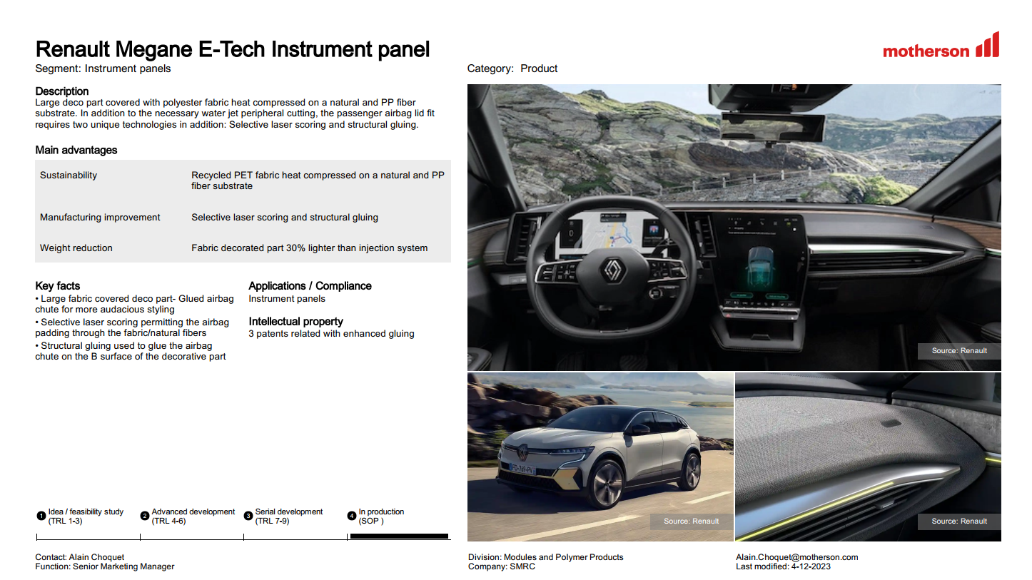

Slide 10
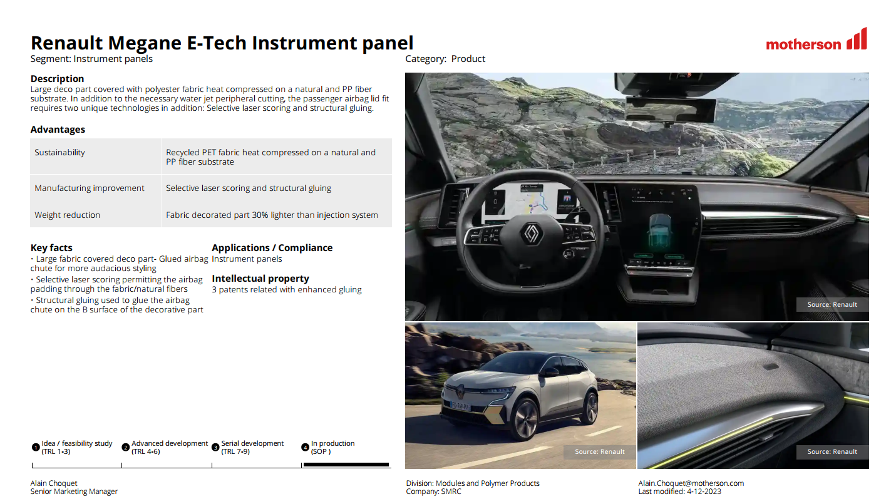

Slide 11
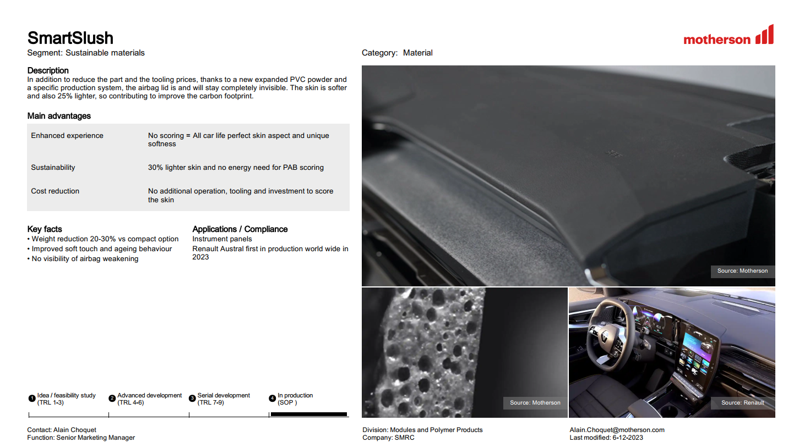

Slide 12
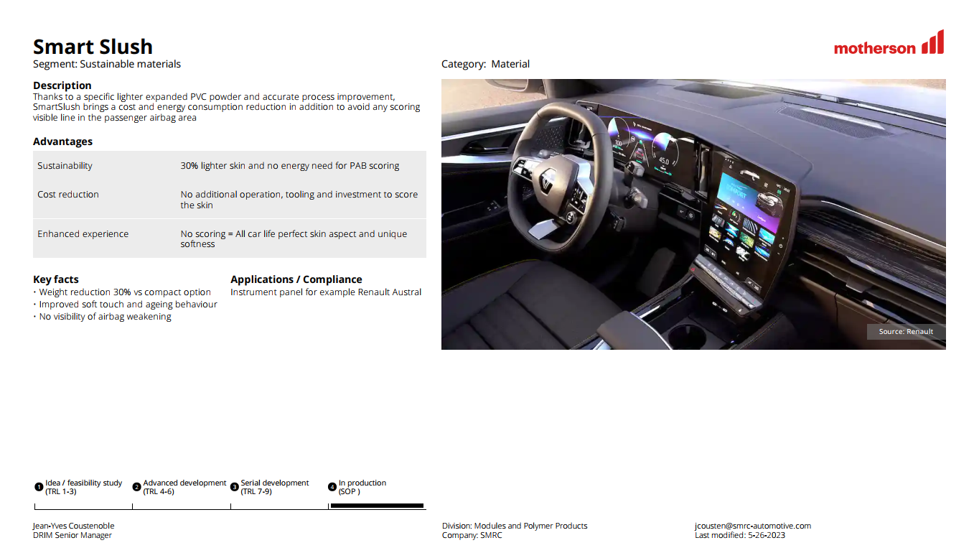

Slide 13
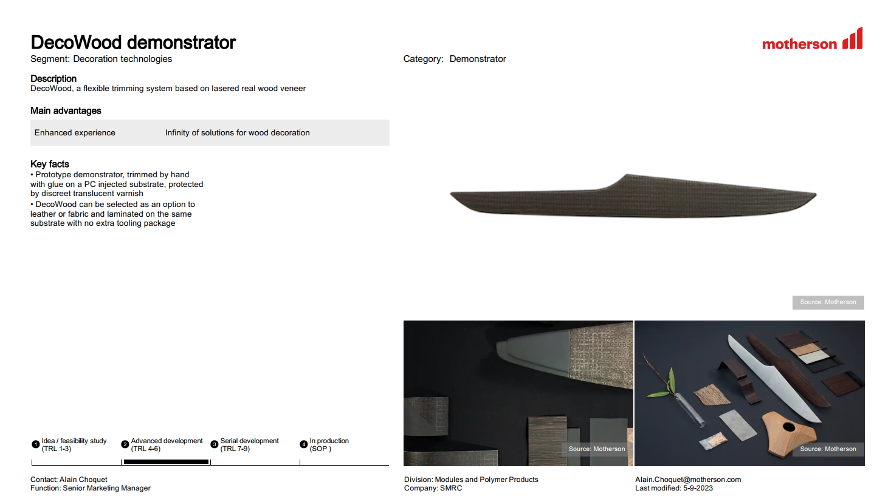

Slide 14
